Slide 1

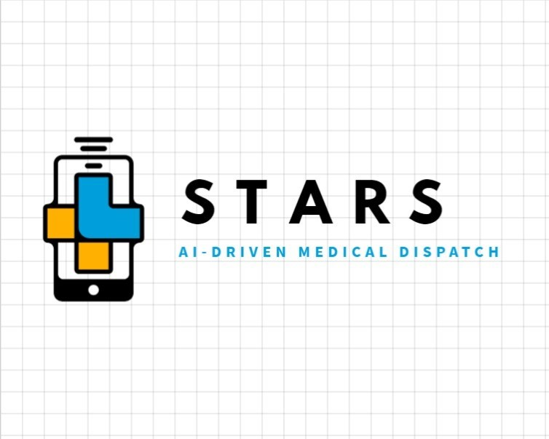


Intern Innovation Challenge
Smart Triaging and Rescue System
Dallas Team 3
Naren Alluri, Derek Fu, Faisal Hasan, Sai Neelanjana, and Eric Zhou
Notes:
Brian Bell: Slides 1-5

Slide 2
650, 000

Slide 3

Problems of Current Dispatching Service
Long and continuous process
Small mistakes lead to improper diagnosis
On average, 10,000 more lives could be saved every year if the response times were to be reduced by 1 minute

Slide 4
Smart Triaging and Rescue System
Notes:
Brian Bell: Slides 1-5

Slide 5





Team Members
Naren Alluri
Software Engineer Intern
Developer
Derek Fu
Data Analyst Intern
Developer/Scrum Master
Faisal Hasan
Network Engineer Intern
Product Owner
Sai Neelanjana
System DevOps Engineer Intern
Scrum Master
Eric Zhou
Software Engineer Intern
Developer/Product Owner

Slide 6
Agenda
1. Introduction
2. Target Users of STARS
3. Design Approach
User Flow, Prototypes, & Software Used
Dataset Creation & AI Workflow
4. Product Demo
5. Benefits & Impact
6. Next Steps and Enhancements
7. Challenges
8. Q&A
9. Appendix

Slide 7
Target Users
Emergency Medical Dispatchers
EMS
Hospital ER Staff
They are the ones that emergency medical 911 calls get transferred to
This includes EMTs and or Paramedics that respond to dispatch calls
This team in the Emergency Room is responsible for connecting with the EMS to get the patient appropriate care
S.T.A.R.S – Dallas IIC / August 2, 2023 / © 2023 AT&T Intellectual Property - AT&T Proprietary (Internal Use Only) ​
Notes:
For target users we focused on three main roles involved in the emergency dispacth process. First being Emergency Medical Dispatchers who receive the 911 medical call, second being the EMS that includes EMTs and paramedics that arrive on scene and lastly Hospital ER Staff who are responsible for communicating with the EMS to make sure the patient reaches the hospitals and receives appropriate care.

Slide 8
User Personas Pain Points
Dispatcher
EMS
High Stress Environment
High Call Volume
Shift Work
While there are similarities, there are also things unique to each role
Decided to make dashboard with role specific views
Multitasking
Emotional impact
Limited Resources
Interoperability
Patient Overcrowding
Fully Optimizing Resources
Data Managment
Hospital ER Staff
Notes:
Through the creation of user personas for each of the roles we found that while there were similarities such as them working in high stress environments there were also a few differences Therefore we created a dashboard with role specific views so they see the same basic information displayed in ways suited to their role.

Slide 9
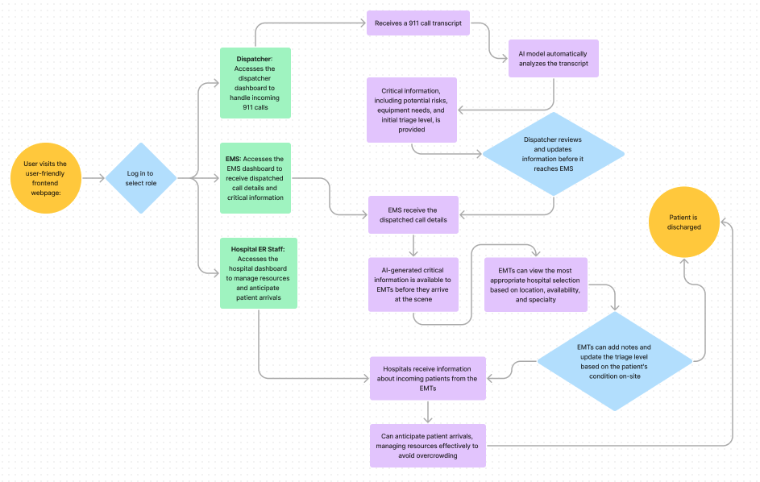
User Flow
Notes:
This is our basic user flow that we will further discuss in the product demo

Slide 10
AI Workflow
Transcripts
Fake Datasets Generated for The Experiment
Experiment
Future
Dataset Name | Information Contained
Personal Information | Basic personal information
Patient Data | Patient names, locations, scripts, and injury types
Recommended Actions & Equipment | AI-generated recommended treatment and equipment for different injury types
Hospital Data | Hospital locations and their specializations
Bag-of-Words Model
AI-Generated & Encrypted Message
Modeling
Best model picked from Auto Machine Learning
Driverless AI or other Deep Learning AI
Results Generation
Predicts top 3 most likely injury types and weighted triage level
Automated process by AI after modeling
Recommendations
Treatment & equipment recommendations and nearest matched hospital
Notes:
If you look at the workflow on the right, you can see that the call transcript is broken down by the model and outputs information such as likely injury type, best hospital to send the patient to, and a weighted triage level. Triage is a scale from 1-5 that medical professionals use to asses how severe a patients conditions is with 1 being needs urgent care and 5 being does not require urgent care. This information is displayed on the front end dashboards that we will talk about soon. Also just to mention all the data used to train and test our AI model was fake data created by the Faker Python package

Slide 11
Product Demo

Slide 12
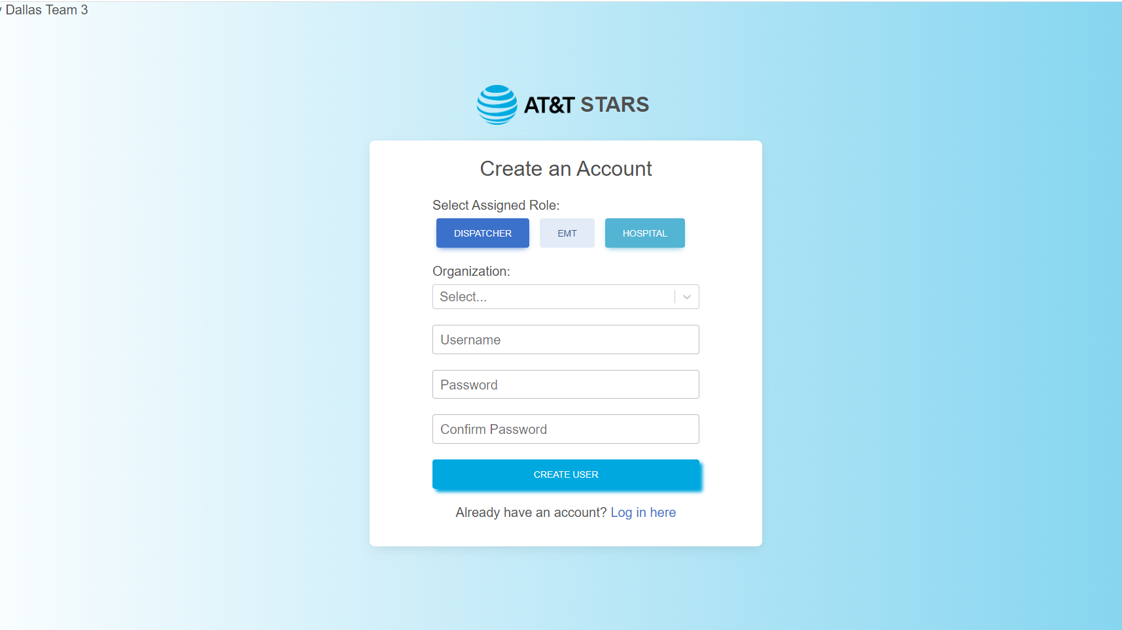

Slide 13
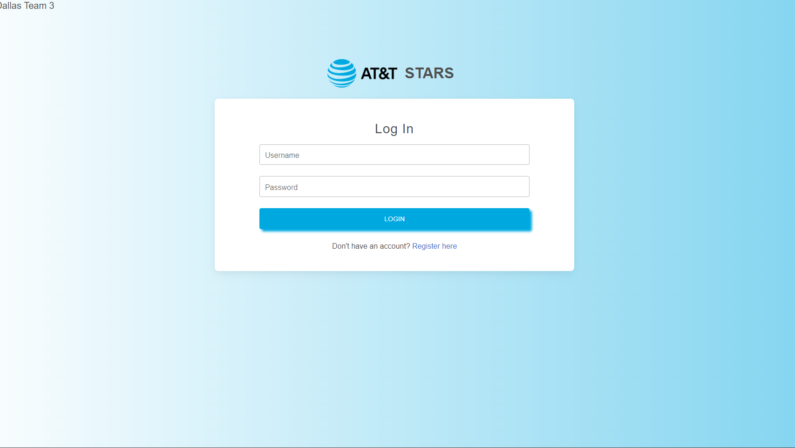

Slide 14
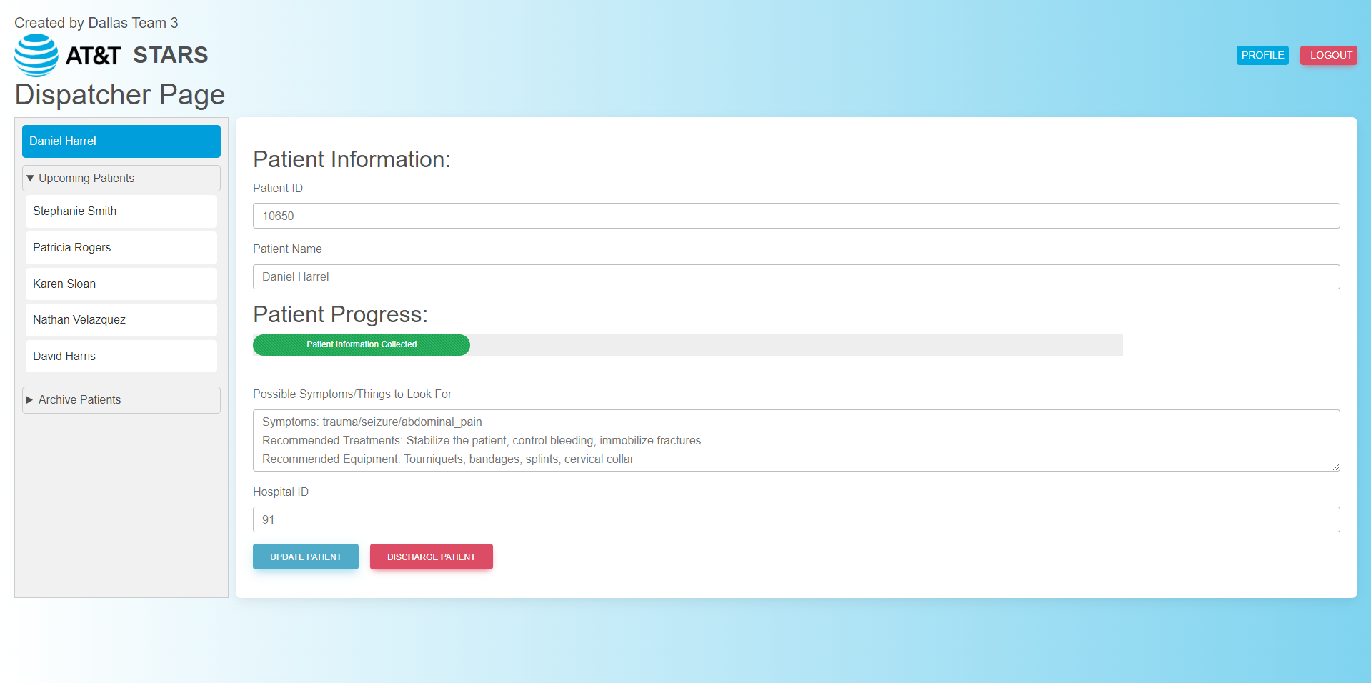

Slide 15
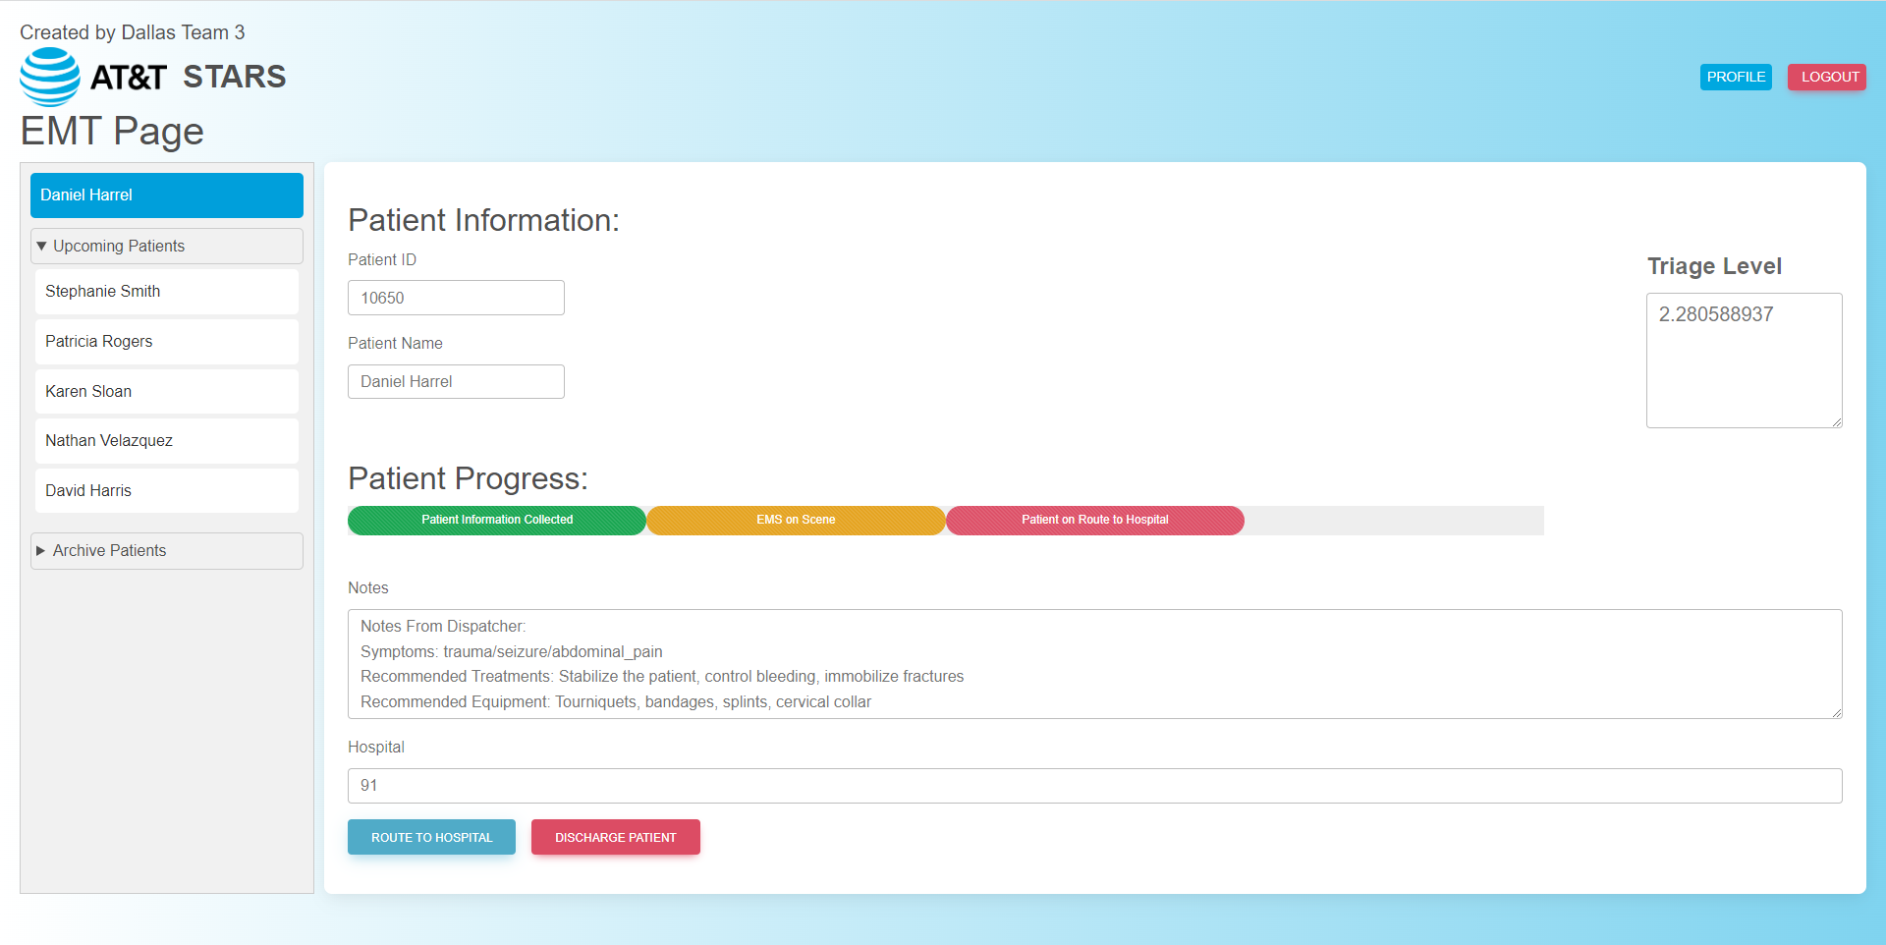

Slide 16
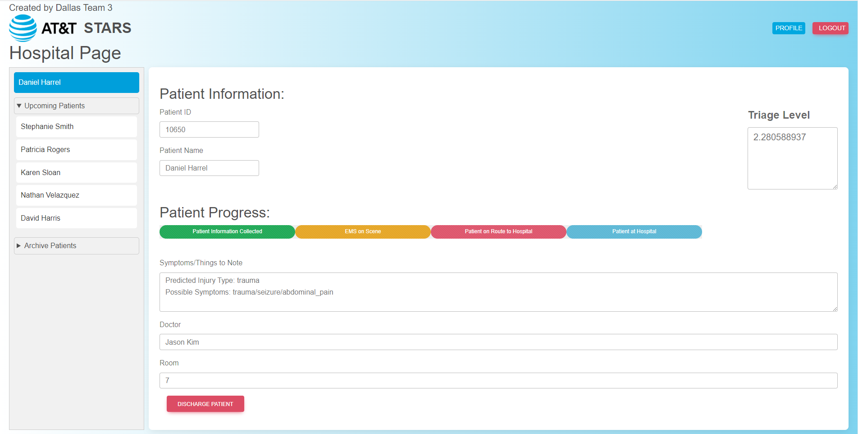

Slide 17

Benefits and Impact for AT&T
More efficient and standardized approach to dispatching
Reduces stress for personnel and minimizes life-threatening mistakes
Enhances FirstNet's value and competitiveness
Generate additional revenue streams
Establish AT&T as an industry leader in the emerging field of AI integration for emergency response
Notes:
Integrating AI into the emergency medical dispatch process enables a more efficient and standardized approach
AI implementation alleviates the demanding nature of EMS personnel's work, reducing stress and minimizing life-threatening mistakes
Our model will be offered as an addon to FirstNet which will enhance FirstNet's value and competitiveness by contributing to its innovation, ensuring AT&T's strong positioning for future government contracts.
Generate additional revenue streams by directly selling the AI-driven application to dispatchers, EMS, and hospitals, leveraging AT&T's 5G and Fiber services.
Establish AT&T as an industry leader in the emerging field of AI integration for emergency response, solidifying market position and expanding offerings for first responders and the public.
NEXT SLIDE

Slide 18
Next Steps and Future Enhancements
Integrate with FirstNet's reliable network
Prioritize Data Transmission
Enhance Interoperability
Leverage advanced communication technologies
Enhance AI-driven solution with real-time video and location tracking
Cross-Platform Applications
Notes:
Our primary objective is to integrate with FirstNet's robust network, prioritizing data transmission for swift and reliable delivery of critical information to first responders. We'll enhance interoperability by ensuring compatibility with public safety communication systems to optimize decision-making in emergencies. Additionally, our AI-driven solution will incorporate real-time video feeds and location tracking for improved triage decisions and patient outcomes. Finally, we want to transform our solution into a cross-platform application will ensure seamless integration across devices and operating systems, broadening its reach and impact, especially in emergent situations.
Next Slide

Slide 19


Challenges
Privacy/Data Security
Data Quality and Availability
Integration with Existing Systems
Algorithmic Bias
Notes:
As we explore the potential future challenges, such as …. It’s important to consider how anticipating and proactively addressing these hurdles will not only strengthen our solution but also ensure its continued adaptability and effectiveness in a dynamic environment.
Next Slide

Slide 20
Thank You!

Slide 21

Q&A
For further information reach out to sn2186@att.com or tf3894@att.com

Slide 22
Appendix
Low Fidelity Prototypes

Slide 23

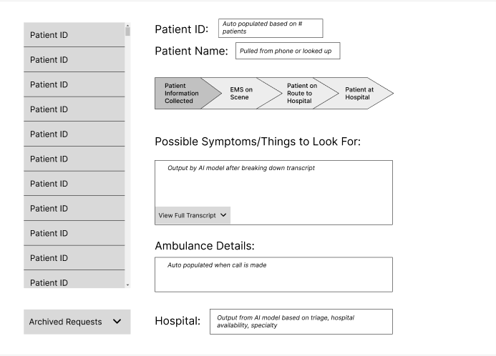
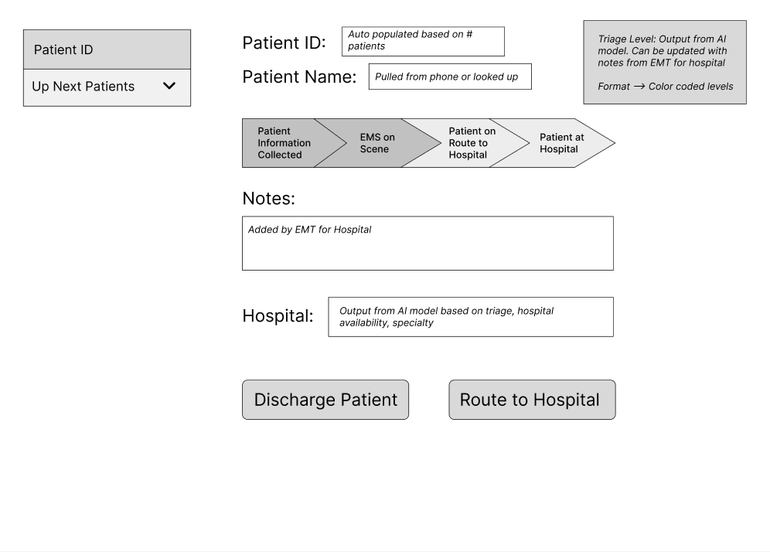
Low Fidelity Prototypes
http://www.att.com/dispatcher
http://www.att.com/ems

Slide 24
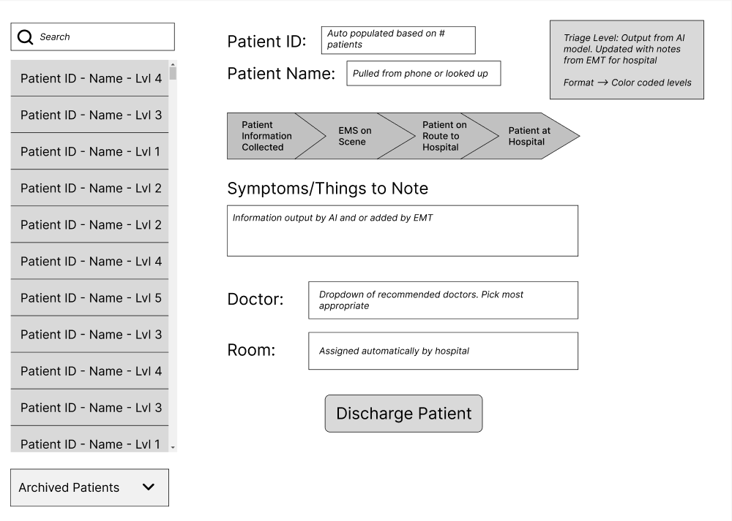
Low Fidelity Prototypes
http://www.att.com/hospital
All three dashboards have the same base design
There are key features for each of the three roles
Key is to make it as user friendly as possible

